Slide 1
WPF and Silverlight, unifying the development platform for Desktop, Web and Mobile
... Or a smaller more catchy title!
Dr. Colin Eberhardt
Technical Architect
Scott Logic Litd.

Slide 2
Overview
The challenges of multiple platforms
Desktop development with WPF
Web development with Silverlight
Mobile development with Windows Phone 7
XAML Finance – a multi-platform application

Slide 3
Platform explosion!
Faster CPUs, longer battery life, smaller devices
Applications delivered across a large range of platforms
... Insert a technology timelline, include desktop PCs, notebooks, netbooks, mobile phone, Smartphone, iPhone, iPad ...

Slide 4
Targeting multiple platforms
Key challenges
Differences in OS
A range of programming languages
Different frameworks and IDEs
Different device capabilities
Form factor influences user experience
Practical impact
Different teams write software for each platform

Slide 5
Desktop Development

Slide 6
Windows Presentation Foundation
A (relatively) new framework for desktop application development
Replacement for Windows Forms
Release date ... ?

Slide 7
WPF Key Features
Data binding
Animation
Styling
3D support
Layout
Rendering transformations
Windows Forms inter-op
and much more ...

Slide 8
WPF - Styling
Demonstrate how styling / templating is a replacement for the ‘owner draw’ concept
Take an example from the ‘Why I Love WPF’ blog post (publishing later this month)

Slide 9
WPF - Databinding
Very flexible
Converters
Property inheritence and precidence
Bind almost anything!
A small example expression ...

Slide 10
WPF data binding - example
Use the codeproject bullet graph example ...

Slide 11
Web Development

Slide 12
Web development challenges
Browser still use HTML / HTTP, technologies developed 20 years ago
HTML is geared towards the layout of static documents
Lacks basic concepts key to application development, e.g. controls
Browser plug-ins fill this gap
Adobe Flash is the market leader

Slide 13
Silverlight
Originally conceived as WPF Everywhere (WPF/E)
Brings the XAML technology to the web
Direct competitor to Adobe Flash
Small download size (5MBytes verify!)
Introduced in 200x

Slide 14
Silverlight Key Features
The same API as WPF
Out of browser support
JavaScript API
The same API as WPF !!!
Databinding
Animation
Styling and templates

Slide 15
Silverlight API
Draw a Venn Diagram of the intersection between WPF & Silverlight APIs

Slide 16
Silverlight Adoption
Get the latest statistics - ~60%
Illustrate the rapid SL4 adoption

Slide 17
Mobile Development

Slide 18
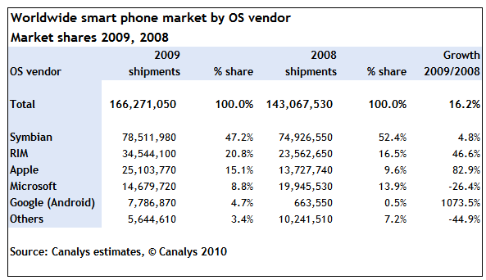
Smartphone market expansion
http://www.canalys.com/pr/2010/r2010021.html
Notes:
23% growth 2008 – 2009 (http://www.gartner.com/it/page.jsp?id=1306513)
Apple and Android the biggest gainers
Microsoft is not doing very well!
http://news.bbc.co.uk/1/hi/technology/10473655.stm

Slide 19
Windows Phone 7
A ‘reboot’ of Windows Mobile
Not backward compatible
Release xxxx 2010
Hardware available xxxx 2010

Slide 20
Windows Phone 7 Key Features
Runs Silverlight!
Also runs XNA

Slide 21
Windows Phone 7 Example
Demonstrate how controls adapt to the WP7 environment

Slide 22
Cross Platform Application

Slide 23
XAML Finance
Demonstration of XAML Finance on
Desktop
Web
Mobile

Slide 24
Conclusions
Three new platforms
Share the same foundations
Share skills between platform teams
Share code between platforms teams

